Slide 1
Introductory General Chemistry
Chemistry 3A
Experiment 11a
Synthesis of Alum
Mitch Halloran

Slide 2

Introduction
An important activity in chemistry is to perform a synthesis, and after that, to determine the yield of the product
The yield calculation:
$$\frac{\text{mass} \text{of} \text{product} \text{obtained} }{theoretical mass of product to be obtained based on mass of reactant}$$

Slide 3
Background
Joseph Proust (1797) stated any sample of a particular compound would be made of same elements in same proportion by mass. This is the Law of Constant Composition.
This principle is connected with the Law of the Conservation of Mass and also Dalton’s Atomic Theory concerning how the atoms of elements are never destroyed or created, but just rearranged in chemical reactions forming new compounds.

Slide 4
Limiting & Excess Reagents
You will learn a very useful concept in chemistry, which is that of the limiting and excess reagents.
In this experiment, the copper solid mass will be the limiting reagent, and sulfur will be the excess reagent.
This means we want ALL the copper mass to completely react with an excess amount of sulfur
So how do we know if all the copper will react?

Slide 5
Experiment Planning
Our lab manual says we should have from 2-4 g sulfur used in the reaction. Let’s assume we are at 2 g sulfur: what is the maximum amount of copper mass we should have for it to completely react with the sulfur we use?
First we to see the chemical reaction that is happening
2 Cu (s) + S (s) → Cu₂S (s)
You should know how to write & BALANCE this reaction because you should know that copper sulfide is copper (I) sulfide. Note how mass is balanced

Slide 6

Experiment Planning
The next step is to know the molar mass of the reactants and the product
Copper: 63.546 g/mol
Sulfur: 32.065 g/mol
Copper (I) sulfide: 2 × Cu + S = 159.16 g/mol
Two atoms of Cu will be used for every one atom of S
Two MOLES (mol) of Cu will be used for every one MOLE (mol) of S
You have 2.00 g S: how many g of Cu will it change?
$2.00 \text{g} \text{S}×\frac{\text{1 }\text{mol} \text{S}}{\text{32.065 }\text{g} \text{S}}×\frac{\text{2 }\text{mol} \text{Cu}}{\text{1 }\text{mol} \text{S}}\text{×}\frac{\text{63.546 }\text{g} \text{Cu}}{\text{1 }\text{mol} \text{Cu}}\text{=}\text{ 7.93 }\text{g} \text{Cu}$
If you consider you can weigh out up to 4.00 g S, then you could consume as much as ~16 g Cu

Slide 7
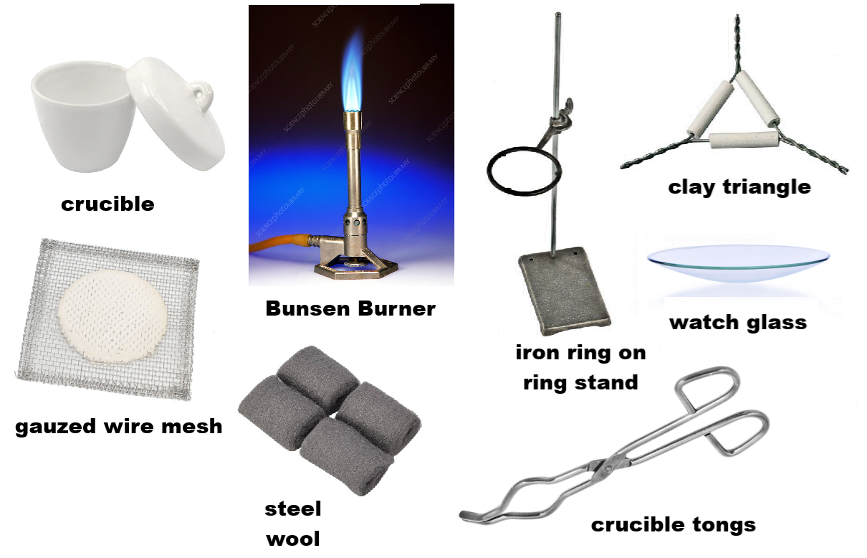
Equipment You Will Use

Slide 8
Procedure
Cleaning the Crucible
If crucible dirty, use small steel wool piece to scrape out solids. Wipe with dry paper towel
Put crucible on stand and heat with blue-coned flame until slightly red hot
Use tongs to set crucible on wire mesh and let cool to room temperature (~5 minutes)
DO NOT SET ANY HOT CRUCIBLE ON COUNTERTOP OR ON PAPER OR THEY CAN BURN!

Slide 9
Procedure
Before Reaction
Determine mass of empty crucible (A)
Get copper wire, coil it to fit in crucible. Record the physical properties, and then the mass of the wire in crucible (B)
On glassine paper, use scoopula to get 2-4 g sulfur. Add to the crucible to cover the coiled wire. Record total mass in crucible (C)

Slide 10
Procedure
Reaction
Heat the contents with a blue flame of the Bunsen burner. The sulfur will melt within about a minute.
Use the crucible tongs to transfer the crucible to the wire mesh. The melted sulfur reacts with the copper during this time.
Put the crucible back on the flame: the unreacted sulfur will burn off, forming sulfur dioxide (SO₂) gas, vented in the hood. The crucible looks clean and dry except for the coil of copper sulfide.
Set the crucible again on the wire mesh to cool
Record mass of crucible with the new compound (D)
Carefully tip crucible contents on to watch glass and make observations of physical properties

Slide 11
Example Data Analysis
Suppose A=23.7584 g, B=34.3532 g, C=37.5732 g. After the reaction, D=36.7841 g
[B-A]=10.5948 g, [C-B]=3.2200 g, [D-A]=13.0257 g
Copper reacted should be same as initial copper, because copper doesn’t go anywhere
Sulfur reacted should be [D-A]-[B-A]=13.0257 g - 10.5948 g= 2.4309 g
Excess sulfur = [C-B]-2.4309 g = 3.2200 g – 2.4309 g =0.7891 g
Mass ratio = copper/sulfur reacted = 10.5948 g/2.4309 g = 4.3583

Slide 12

Example Data Analysis
What does the mass ratio show?
For every 1 g of S, there are about 4.4 g Cu
Look at the molar masses of S and Cu.
If there are 32.065 g/mol S and 63.546 g/mol Cu, and there are 2 mol Cu and 1 mol S in Cu₂S, then what is the theoretical mass ratio of S to Cu in Cu₂S?
$$\frac{\frac{\text{63.546 }\text{g} \text{Cu}}{\text{mol} \text{Cu}}\text{×}\text{2 }\text{mol} \text{Cu}}{\frac{\text{32.065 }\text{g} \text{S}}{\text{mol} \text{S}}\text{×}\text{1 }\text{mol} \text{S}}=\frac{\text{3.9636 }\text{g} \text{Cu}}{\text{1 }\text{g} \text{S}}$$
4.4 g Cu/g S seems close to 4.0 g Cu/g S. How close can you get?

Slide 13
Clean Up
The copper sulfide product goes into solids waste container
WITHOUT AT ALL GETTING CRUCIBLE WET WITH ANY WATER, wipe crucible with dry paper towel
Use soapy water to clean the watch glass
Place all other items in appropriate locations

